Slide 1
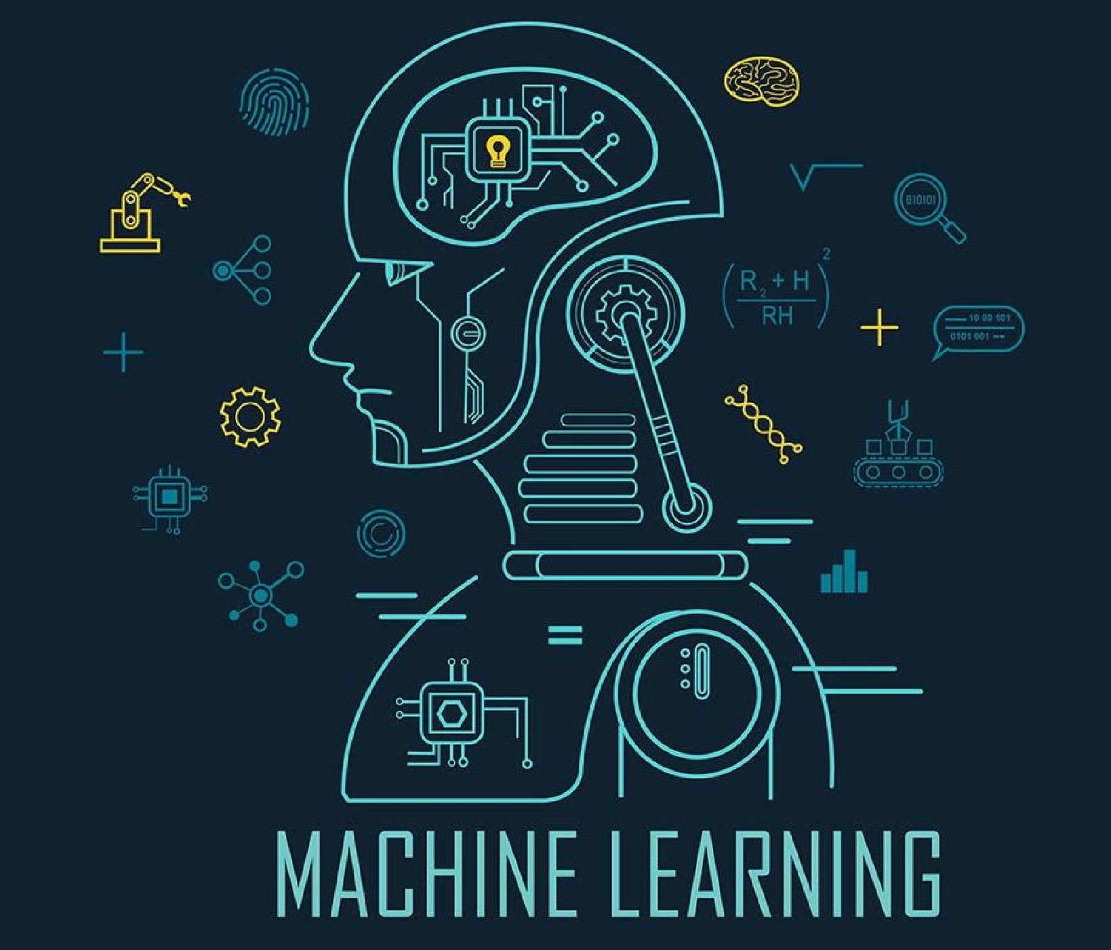


IT 323
ML: Machine Learning
Conducted by Ruchika Pharswan
at Delhi Technological University
8 Aug 2024

Slide 2




Brief About Me
Email : ruchikapharswan2024@gmail.com
B.Tech (CSE) M.Tech (CSE) || Ph.D. coursework graduated
Teaching Assistant IIT Delhi, Assistant Prof. GGSIPU, TA IIHT
Journal, Book Chapters, Conferences papers || Active Reviewer
Governance of AI ,Technology Adoption, Social Media Analysis, User Behavior,
Lecture Presentation | Ruchika Pharswan @Delhi Technological University
2
Jens Martensson

Slide 3
INSTRUCTIONS
NO entry in class after 15 mins , once class the started.
NO proxies attendance. NO back attendances will be given.
If there will be mass bunk, then for next lecture, few of you will be randomly selected to present assigned topics.
Topic presentation (10), Assignments (5) will hold weightage of CWS component.
Also feel free to ask any doubts in class or even after class you can drop your query in AIES WhatsApp group. Kindly send your rest of the requests and queries to CR , refrain individual messages unless important. Thanks.
DO NOT UPLOAD THIS PPT. ANYWHERE !
Lecture Presentation | Ruchika Pharswan @Delhi Technological University
Jens Martensson

Slide 4
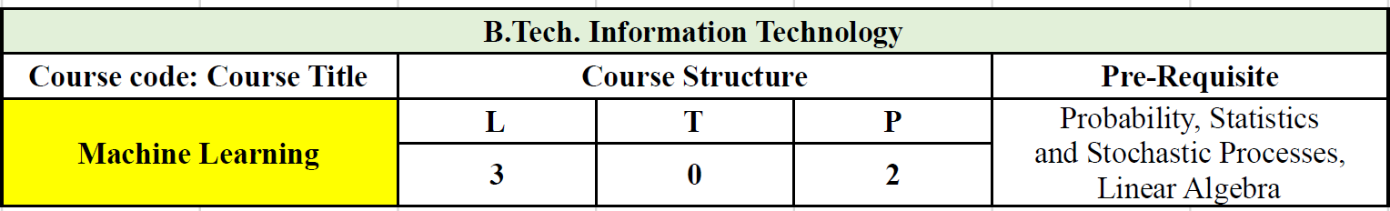
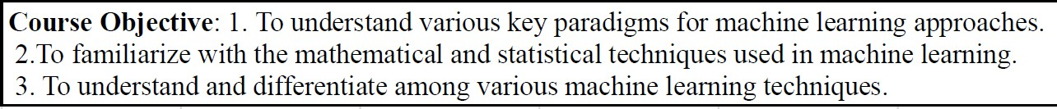
By the end of this course you can assure following :
Understand the fundamental concepts and algorithms of machine learning.
Develop a comprehensive understanding of fundamental machine learning concepts, algorithms, and techniques, including supervised and unsupervised learning, classification, regression, clustering, and dimensionality reduction.
Apply principles and algorithms to evaluate models generated from data.
Learn to critically evaluate the performance of machine learning models using appropriate metrics.
Develop the ability to identify and formulate problems suitable for machine learning solutions, design appropriate models, and interpret results in practical applications.
Jens Martensson

Slide 5
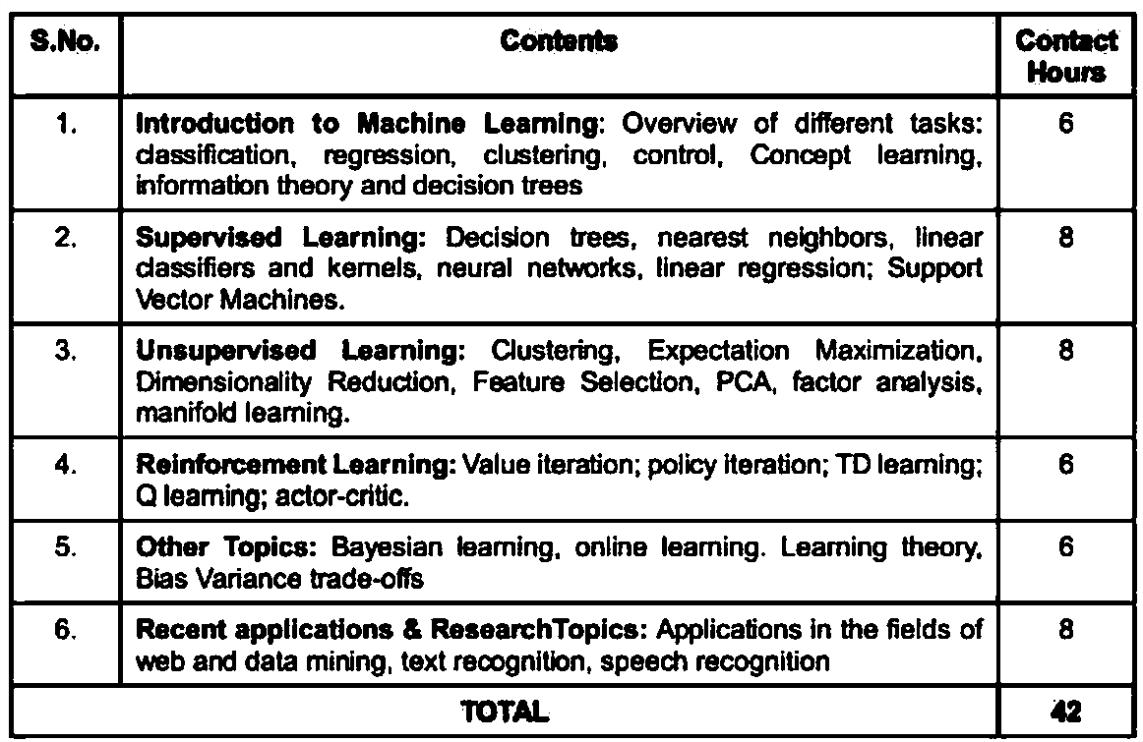
Course Outline
Jens Martensson

Slide 6
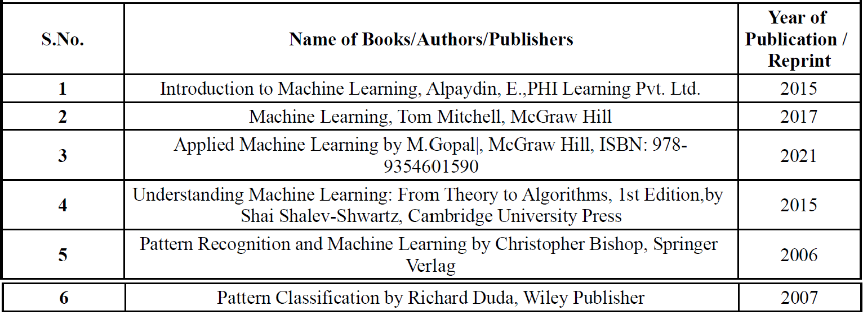
Jens Martensson

Slide 7



UNIT 1
Introduction to machine learning
Sources : | Books, Internet, Self
Referring to | Prof. Dinesh Kumar Vishwakarma | Lecture | Notes.
Lecture Presentation | Ruchika Pharswan @Delhi Technological University
Jens Martensson

Slide 8
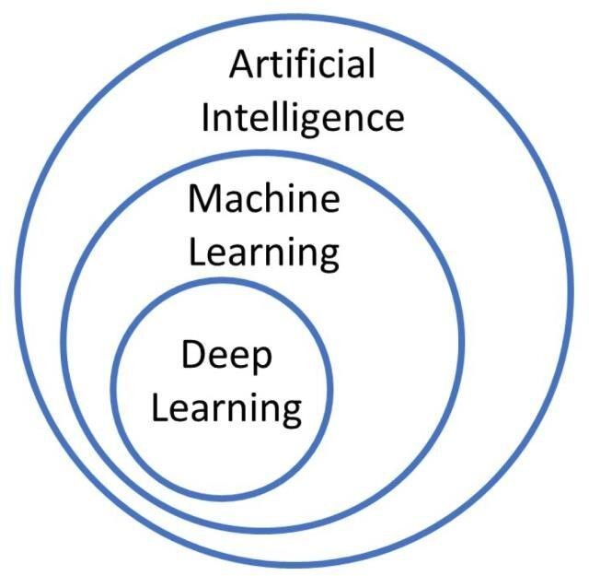
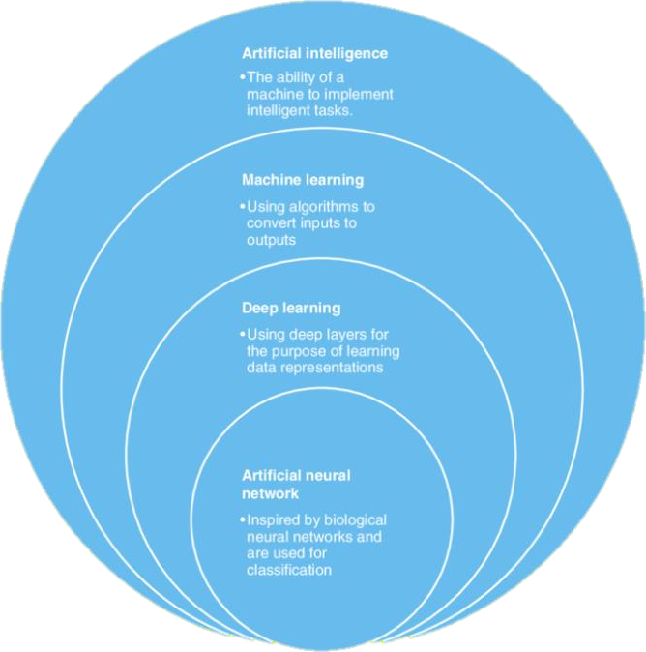
Machine learning is an application of artificial intelligence (AI) that provides systems the ability to automatically learn and improve from experience without being explicitly programmed. Machine learning focuses on the development of computer programs that can access data and use it learn for themselves.
Lecture Presentation | Ruchika Pharswan @Delhi Technological University
Jens Martensson

Slide 9
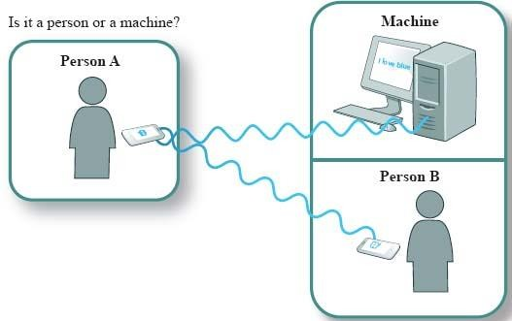
Any hunches ?
Foundation of AI : Turing Test
Alan Turing
The Turing Test is a method of inquiry in artificial intelligence (AI) for determining whether or not a computer is capable of thinking like a human being.
Fool the tester

Slide 10
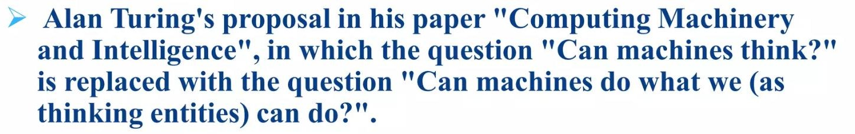
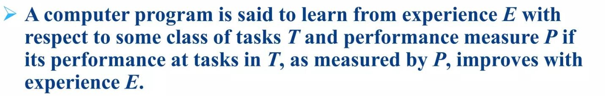
The Turing Test was the technique of exploration in AI for deciding whether or not a computer is competent of thinking
like a human being.
Limitation of Turing test : Nature of question was limited
Computer score high only if the questions were formulated in the queries, that can be answered either in "Yes" or "No“
or related to a narrow field of knowledge.
Whereas when questions were open-ended and needed conversational answers, computer scored less.

Slide 11
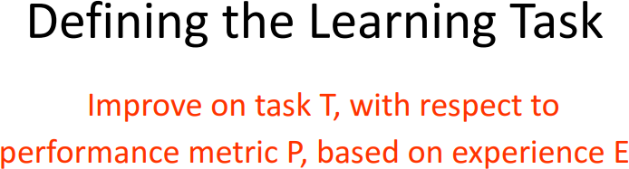
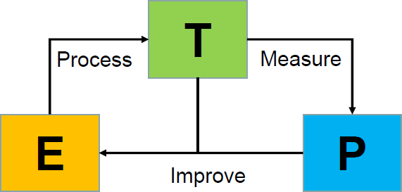
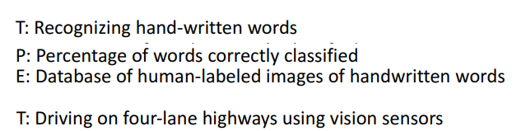
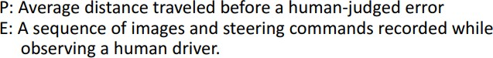
Lecture Presentation | Ruchika Pharswan @Delhi Technological University
Jens Martensson

Slide 12
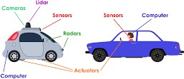
PEAS Representation
PEAS stands for PERFORMANCE , ENVIRONMENT, ACTUATORS, SENSORS.
PEAS is a type of model on which an AI agent works upon. When we define an AI agent or rational agent, then we can group its properties under PEAS representation model. Here performance measure is the objective for the success of an agent's behavior.
Let's suppose a self-driving car then PEAS representation will be:
Performance: Safety, time, legal drive, comfort
Environment: Roads, other vehicles, road pedestrian
signs,
Actuators: Steering, accelerator, brake, signal, horn
Sensors: Camera, sonar.
Lecture Presentation | Ruchika Pharswan @Delhi Technological University
Jens Martensson

Slide 13
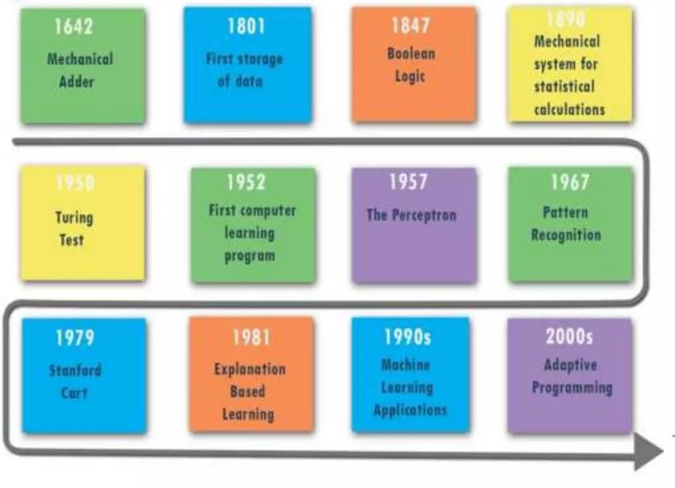
History of Machine learning

Slide 14
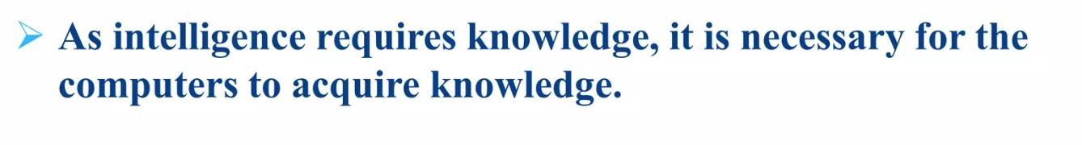

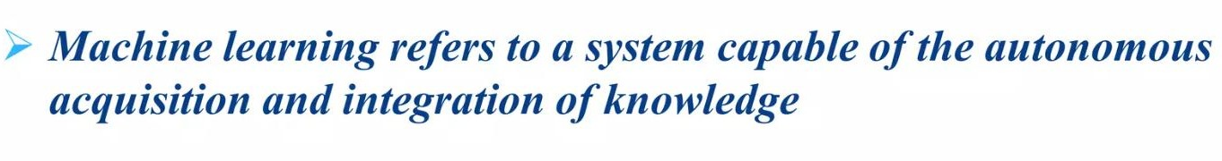
Requires
Knowledge
Complicated
Voluminous
Dynamic Challenging to identify accurately
Intelligence requires knowledge. Knowledge is collection of facts.
ML technique is a method that achieves knowledge.
Intelligence

Slide 15
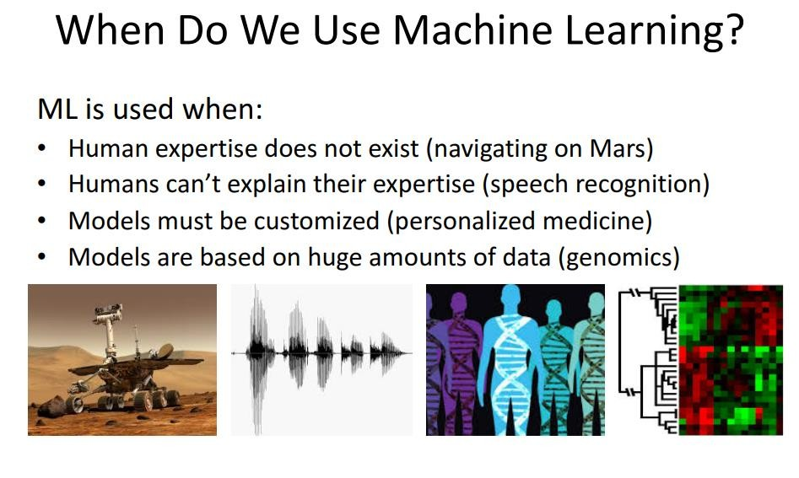
No Human Expertise, Unknown Challenges, data driven learning
Jens Martensson

Slide 16
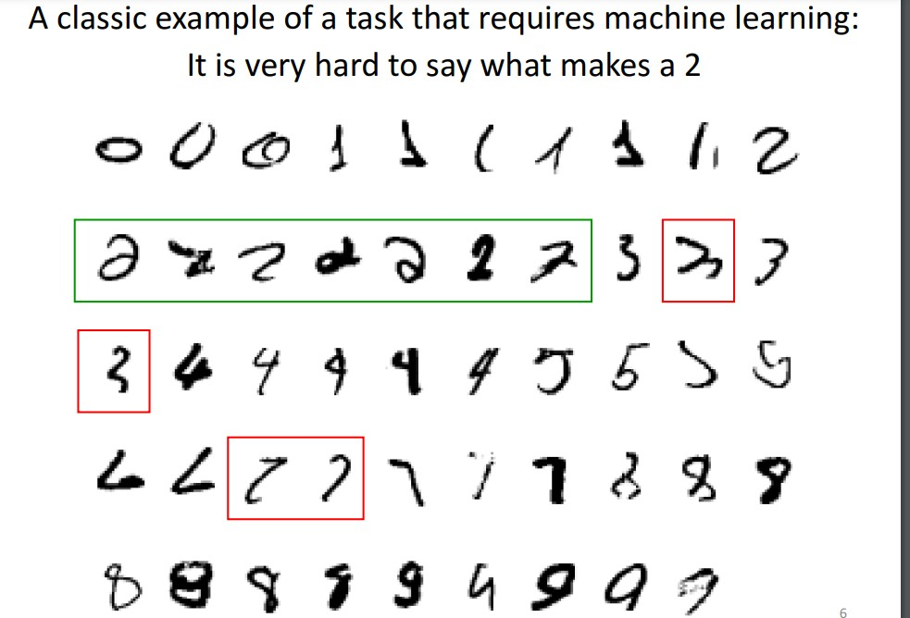
Lecture Presentation | Ruchika Pharswan @Delhi Technological University
Jens Martensson

Slide 17
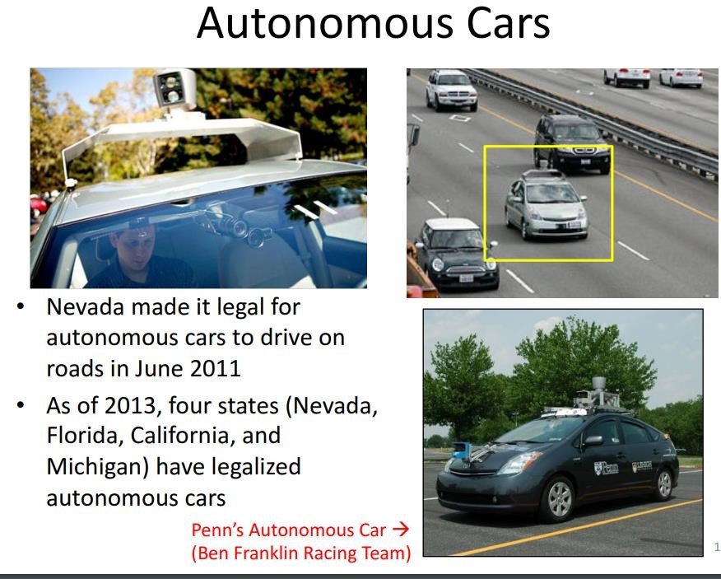
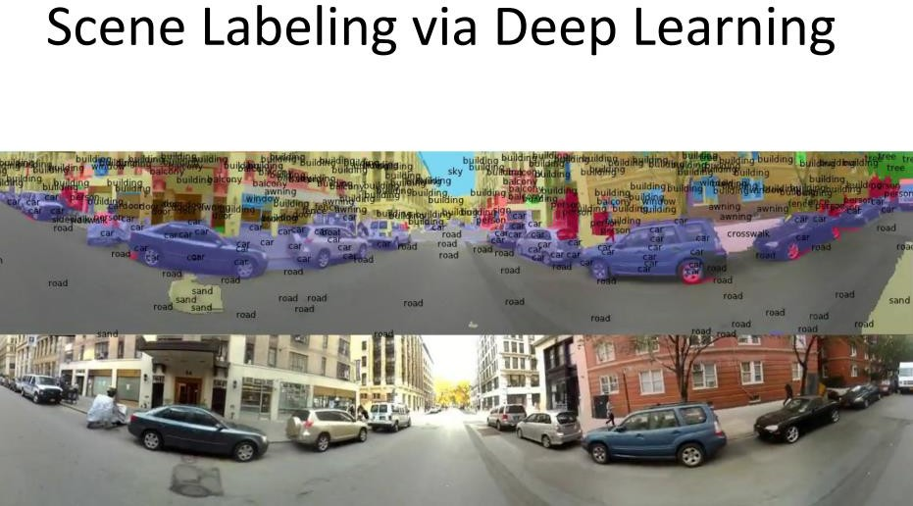


Lecture Presentation | Ruchika Pharswan @Delhi Technological University
Jens Martensson

Slide 18
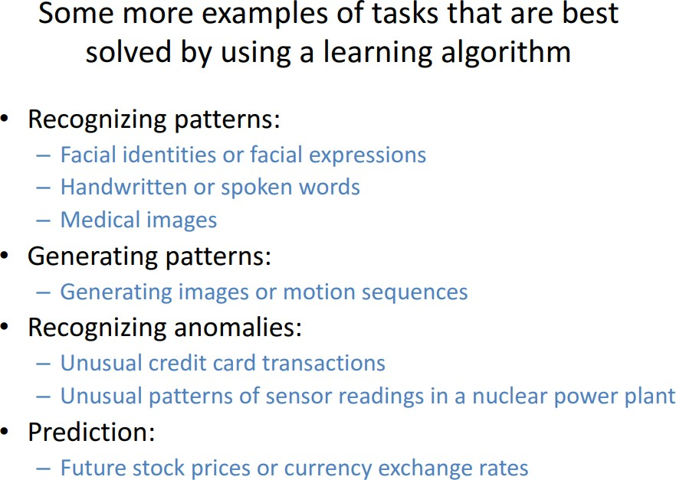
Lecture Presentation | Ruchika Pharswan @Delhi Technological University
Jens Martensson

Slide 19
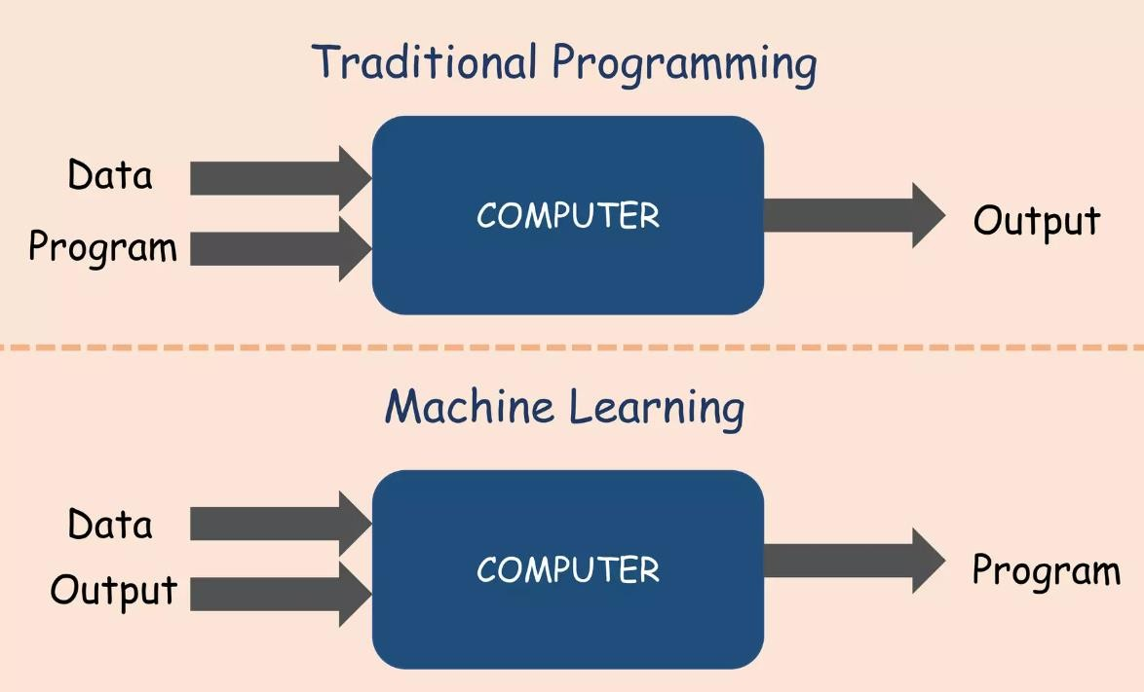
Machine Learning
System
Inputs: Data + Output
Data: Similar to the traditional system, this is the information you want to work with.
However, in a machine learning context, this data is typically much larger and more complex.
Output: This is the desired result that you want the system to produce based on the data.
(Labels)
(Model)
For example, if you want a machine learning model to recognize cats in images, the output could be labels indicating whether a cat is present in each image.
TRAINING

Slide 20

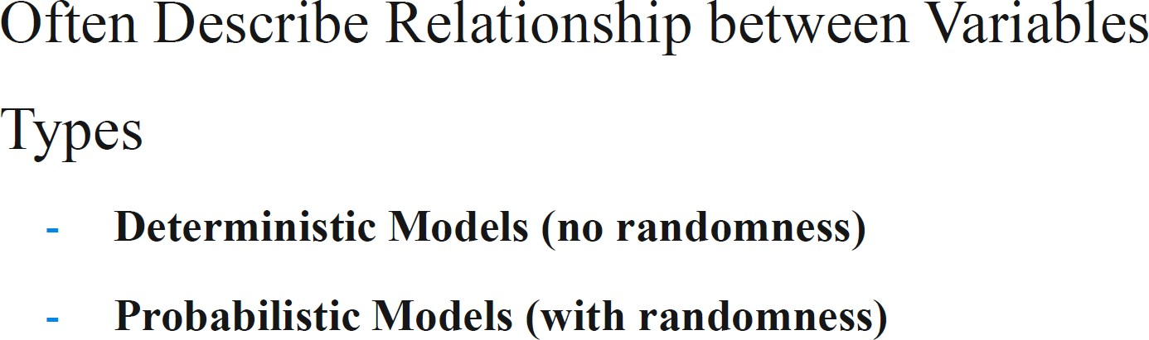
Output: Program (Model)
Representation of Some Phenomenon
Non-Maths /Stats Model
A MODEL is a mathematical or computational representation that encapsulates patterns, relationships, or rules that have been learned from data.
A model in machine learning is a learned representation that can make predictions or decisions based on input data. It’s the core of what makes machine learning systems powerful and adaptable.

Slide 21
How a Model Works
Training:
During the training phase, a machine learning algorithm processes a dataset that includes both input data and the corresponding desired outputs (also known as labels or targets).
The algorithm adjusts its internal parameters in such a way that it can map the input data to the correct output. These internal parameters form the model.
Inference:
After training, the model can take new, unseen input data and apply the learned rules or patterns to predict an output.
Model Output
After training, the model can make predictions, classify data, or even generate new content based on what it has learned.
TASK OF MACHINE LEARNING

Slide 22
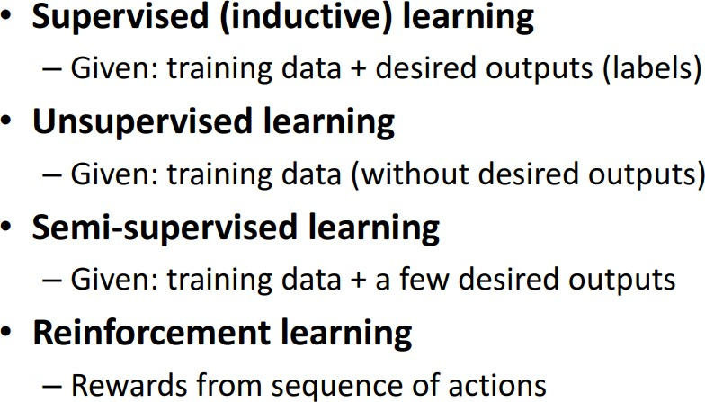
Types of Models
Supervised Learning Models: Trained on labeled data, where the correct output is provided during training.
Unsupervised Learning Models: Learn from unlabeled data, identifying patterns or structures in the data without explicit outputs.
Reinforcement Learning Models: Learn by interacting with an environment, receiving feedback in the
form of rewards or penalties.

Slide 23
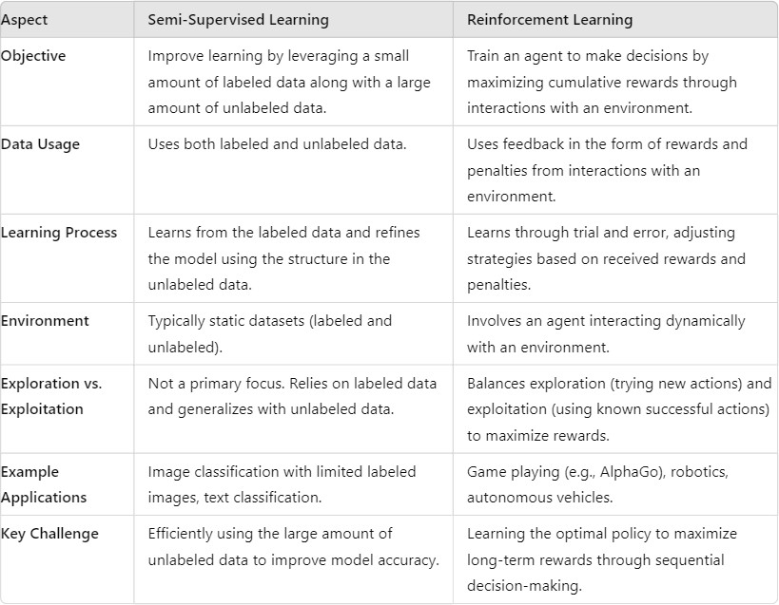

Slide 24
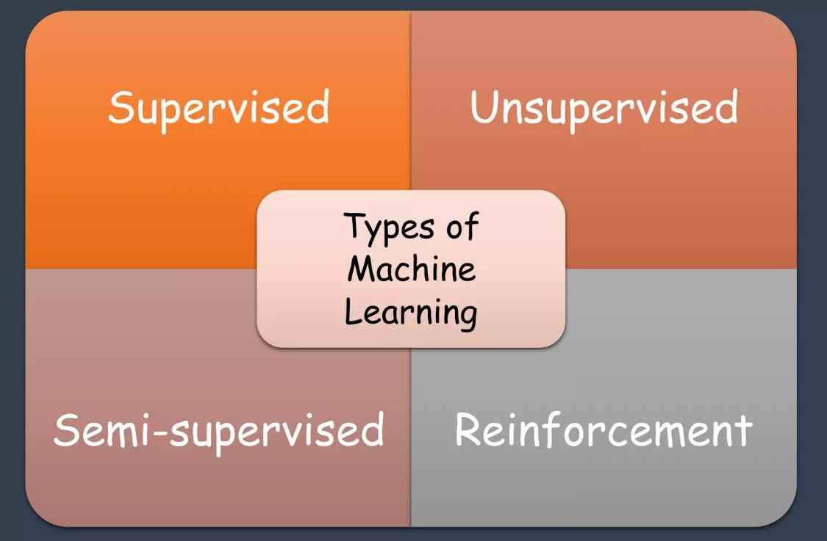
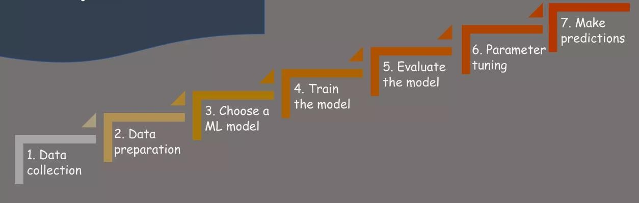
Steps in ML

Slide 25
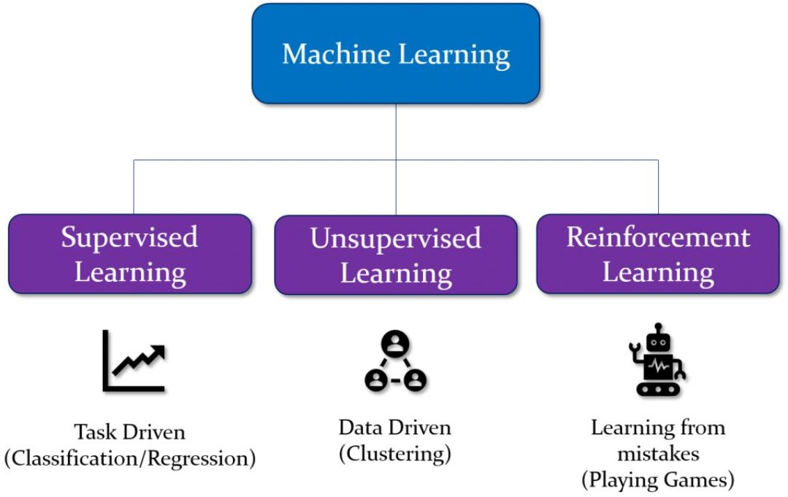

Slide 26
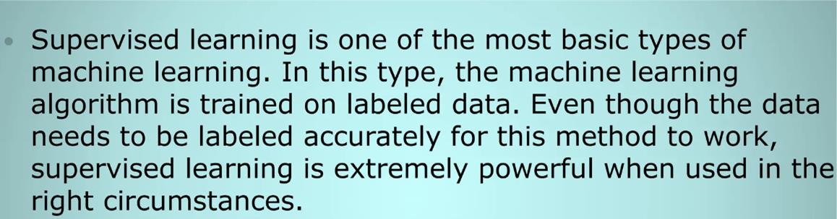
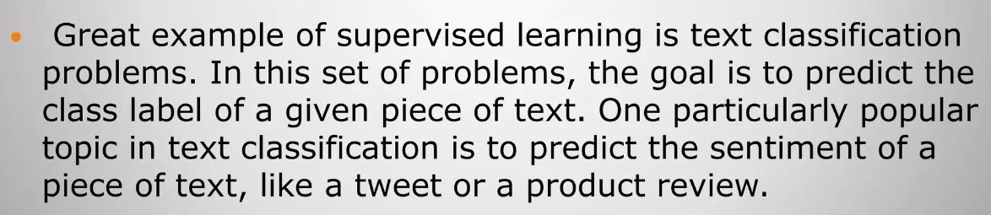

Slide 27
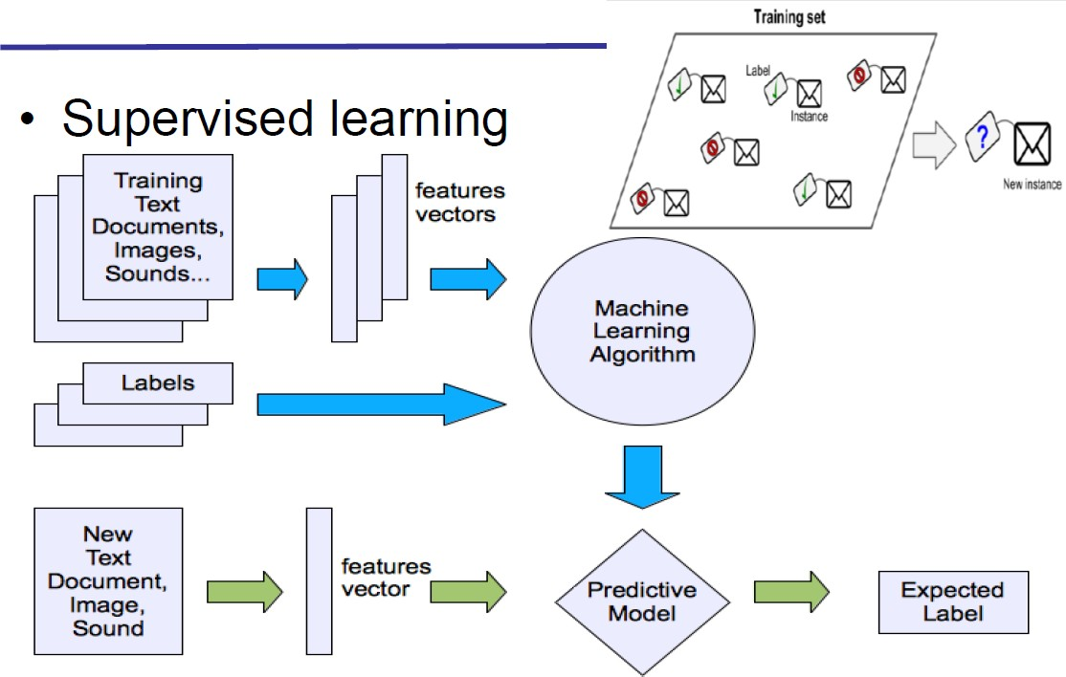

Slide 28
Supervised Learning
Supervised learning involves learning a function that maps input data to output labels, based on a set of input-output pairs. The model is trained on labeled data, where the correct output is provided for each input in the training set.
Classification:
Objective: Predict a categorical label for given input data.
Example: Spam detection in emails (spam or not spam), image recognition (cat or dog).
Algorithms: Logistic Regression, Decision Trees, Support Vector Machines (SVM), k- Nearest Neighbors (k-NN), Neural Networks.
Regression:
Objective: Predict a continuous value for given input data.
Example: Predicting house prices, forecasting stock prices.
Algorithms: Linear Regression, Ridge Regression, Lasso Regression, Neural Networks.
Regression,
Polynomial

Slide 29

The iris dataset contains three classes of flowers, Versicolor, Setosa, Virginica, and each class contains 4 features, ‘Sepal length’, ‘Sepal width’, ‘Petal length’, ‘Petal width’. The aim of the iris flower classification is to predict flowers based on their specific features.

Slide 30
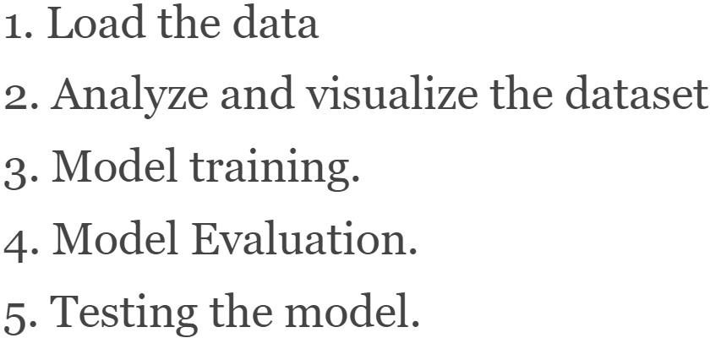
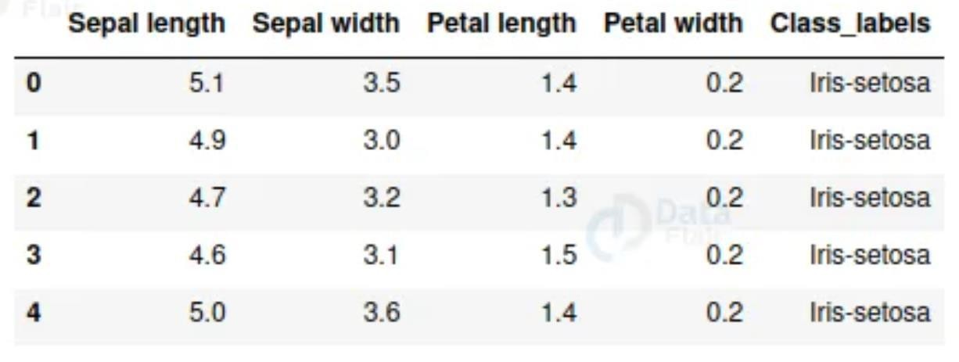

Slide 31
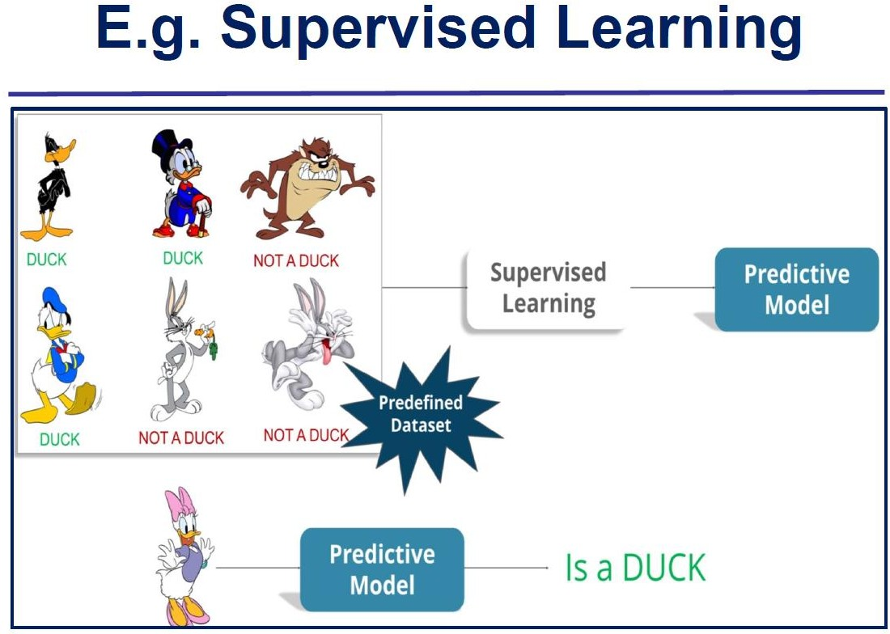

Slide 32
Unsupervised Learning
Unsupervised learning involves finding hidden patterns or intrinsic structures in input data that is not labeled. The model tries to learn the structure or distribution of the data without any supervision.
Clustering:
Objective: Group similar data points together based on some notion of similarity.
Example: Customer segmentation, grouping similar documents.
Algorithms: k-Means, Hierarchical Clustering, DBSCAN, Gaussian Mixture Models (GMM).
Anomaly Detection:
Objective: Identify rare items, events, or observations that do not conform to the general distribution of the data.
Example: Fraud detection, network security.
Algorithms: Isolation Forest, One-Class SVM, Auto encoders.
Lecture Presentation | Ruchika Pharswan @Delhi Technological University

Slide 33
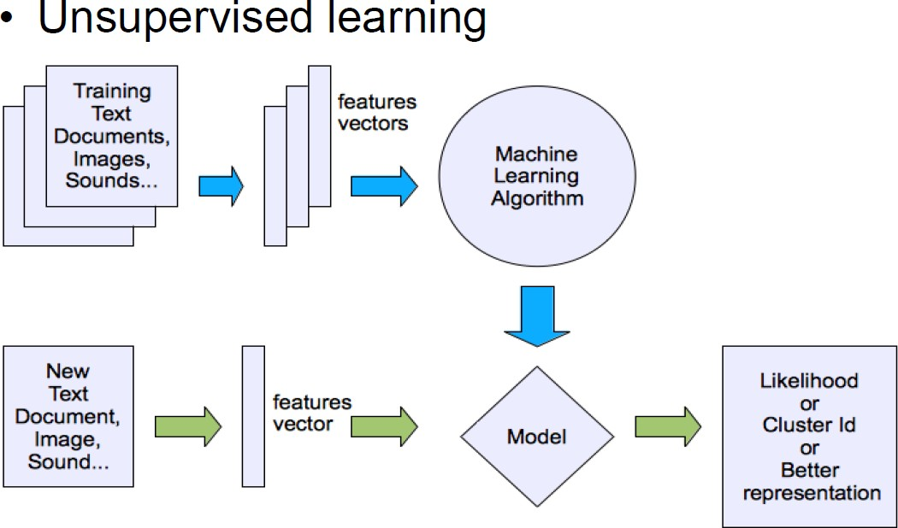
Lecture Presentation | Ruchika Pharswan @Delhi Technological University

Slide 34
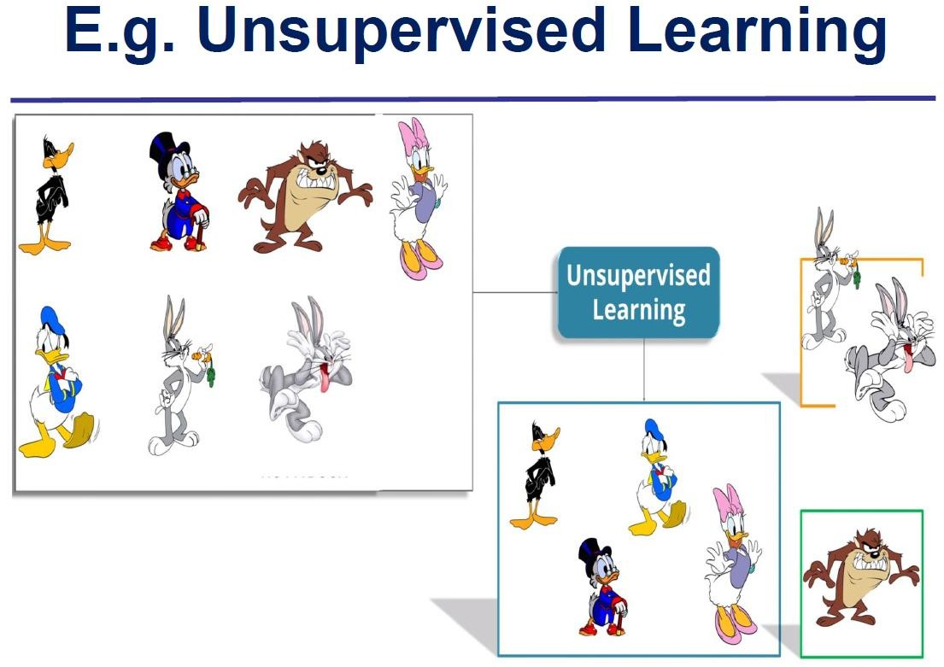
Lecture Presentation | Ruchika Pharswan @Delhi Technological University

Slide 35
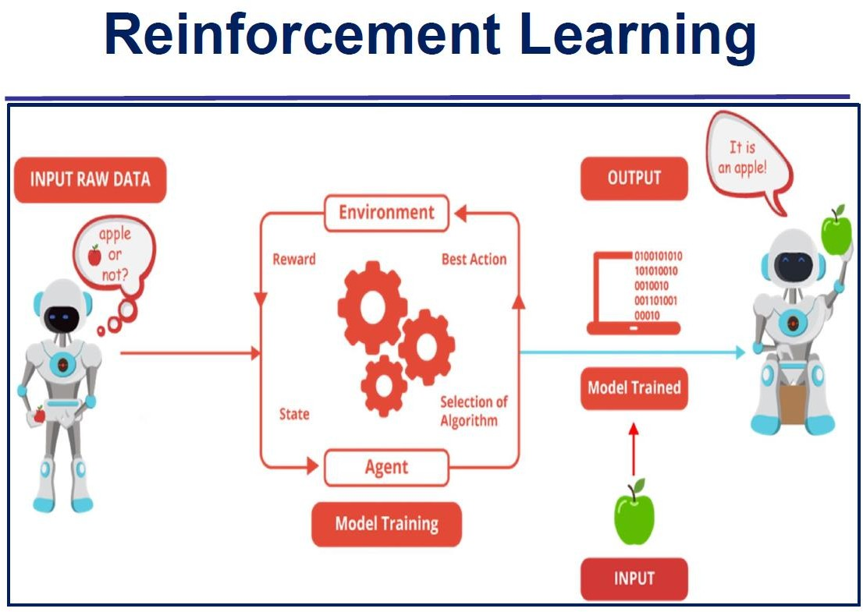
Lecture Presentation | Ruchika Pharswan @Delhi Technological University

Slide 36
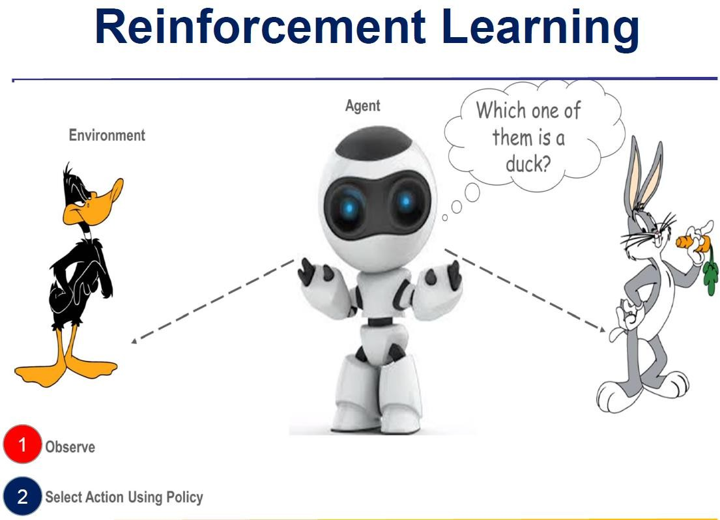
Lecture Presentation | Ruchika Pharswan @Delhi Technological University

Slide 37
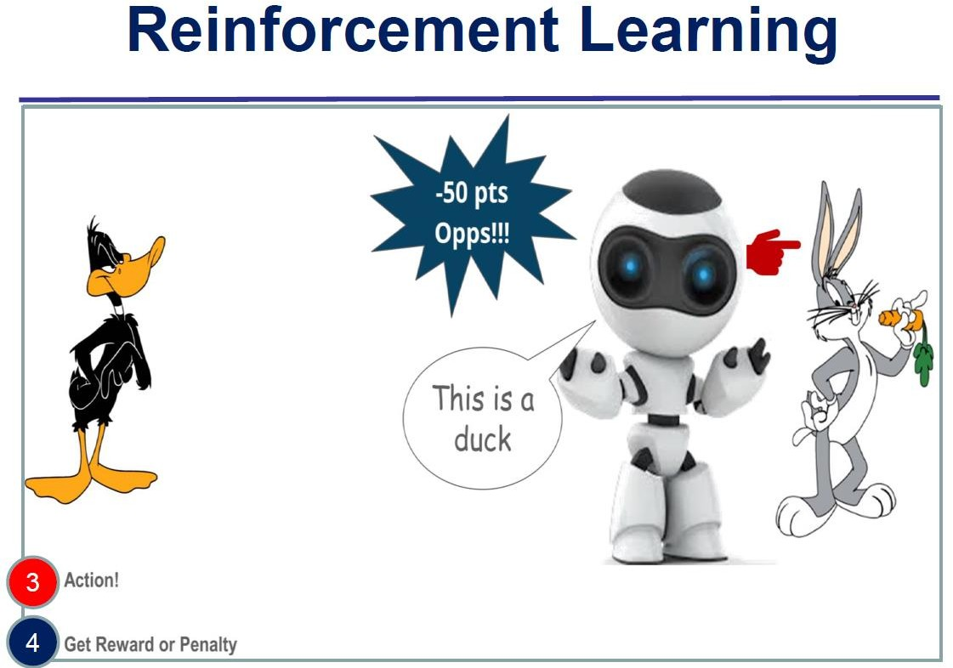
Lecture Presentation | Ruchika Pharswan @Delhi Technological University

Slide 38
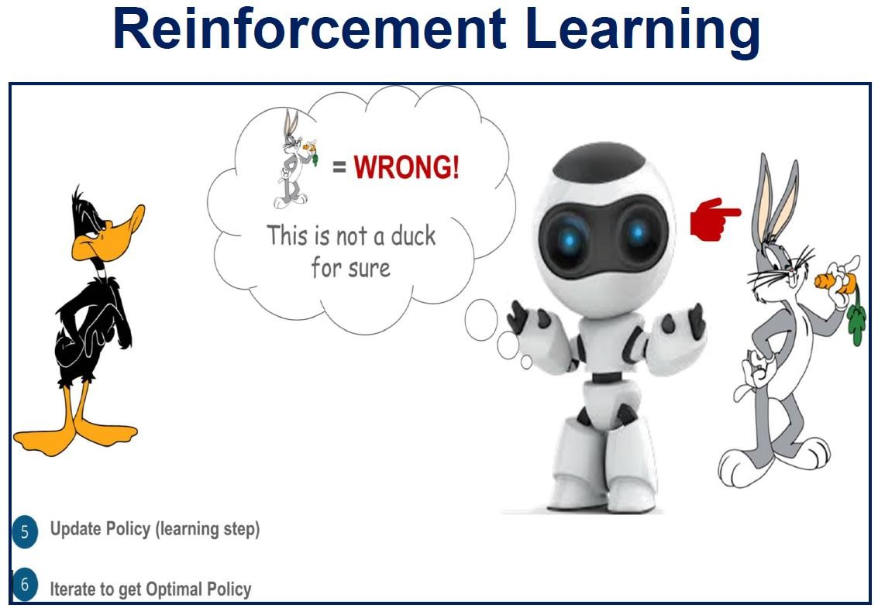
Lecture Presentation | Ruchika Pharswan @Delhi Technological University

Slide 39
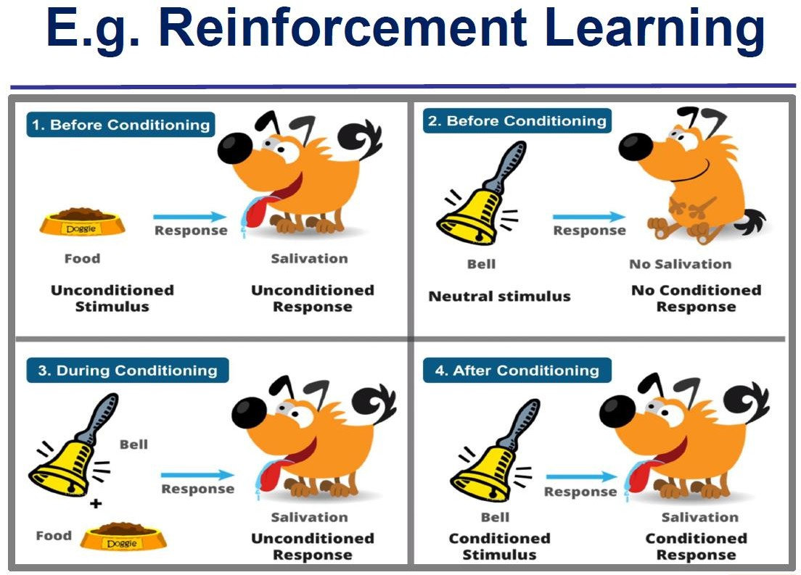
Lecture Presentation | Ruchika Pharswan @Delhi Technological University

Slide 40
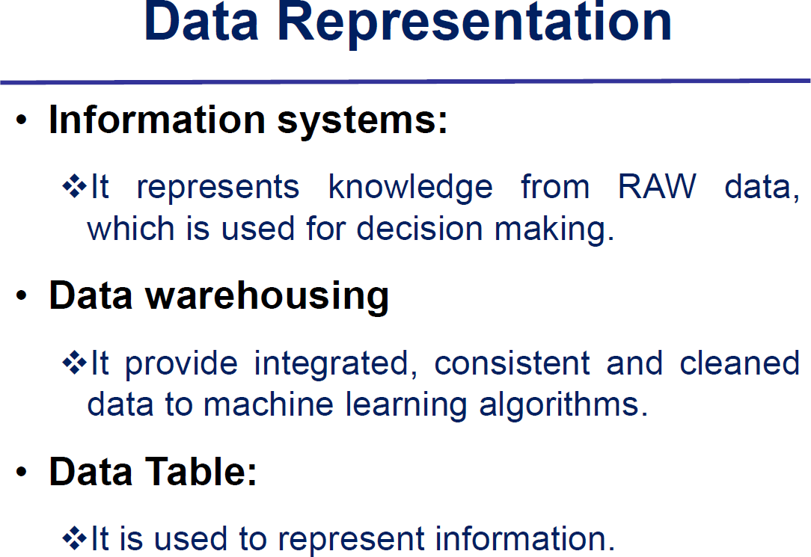
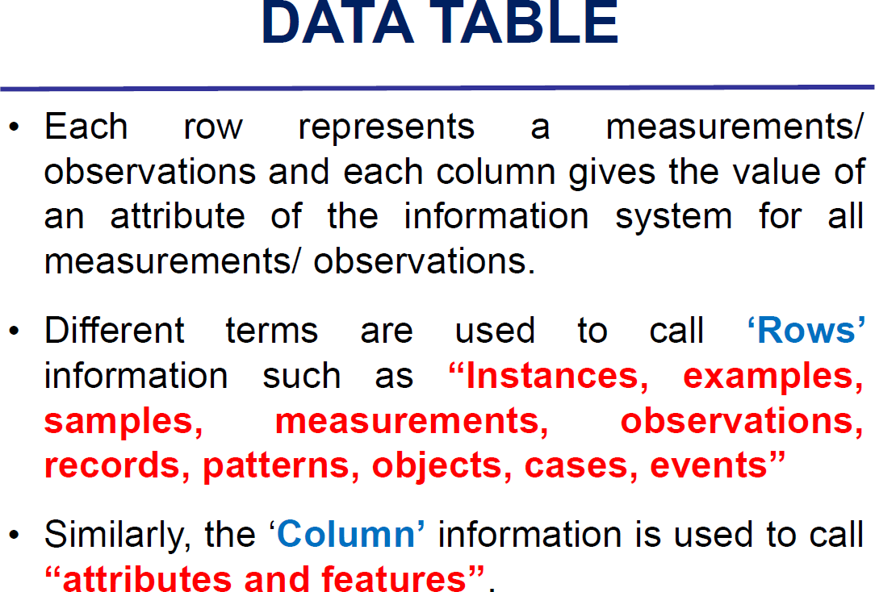
Lecture Presentation | Ruchika Pharswan @Delhi Technological University

Slide 41
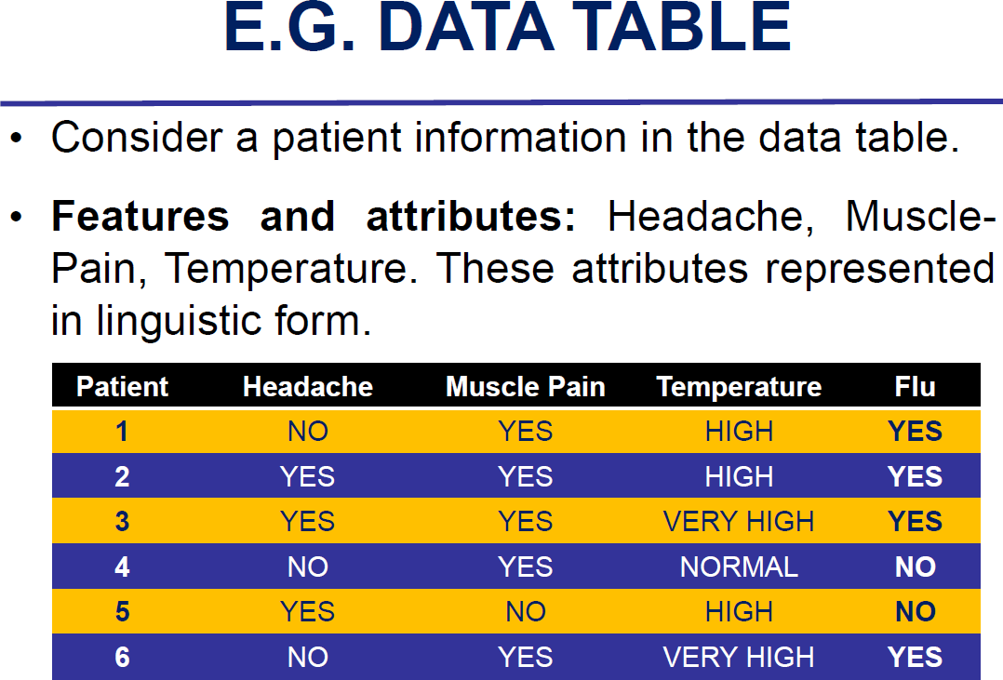
Lecture Presentation | Ruchika Pharswan @Delhi Technological University

Slide 42
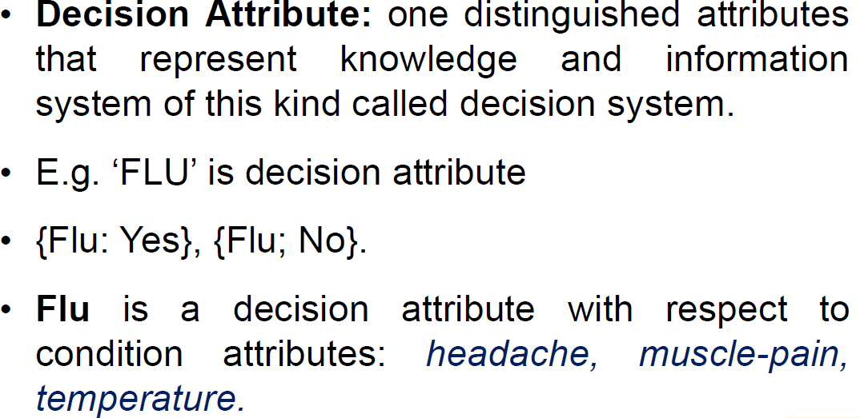
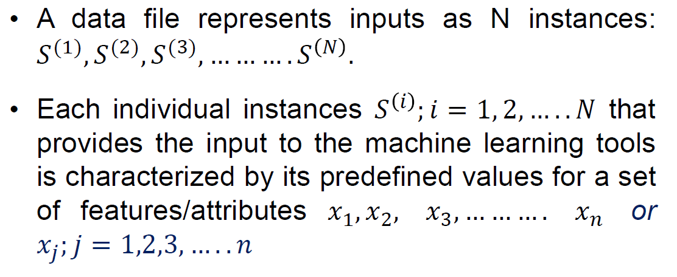
Lecture Presentation | Ruchika Pharswan @Delhi Technological University

Slide 43
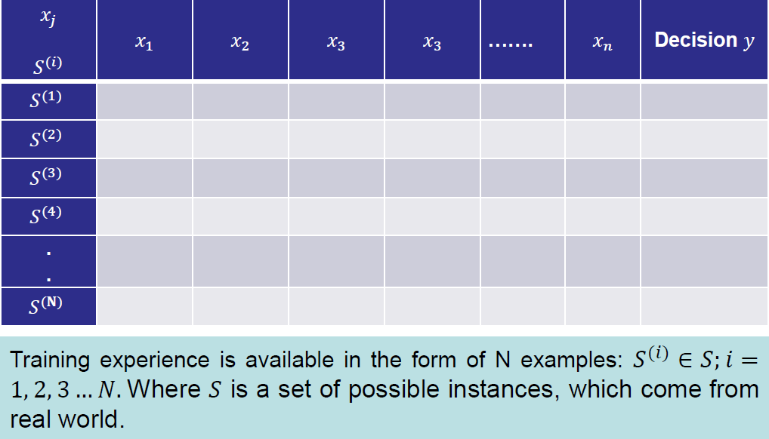
Lecture Presentation | Ruchika Pharswan @Delhi Technological University

Slide 44
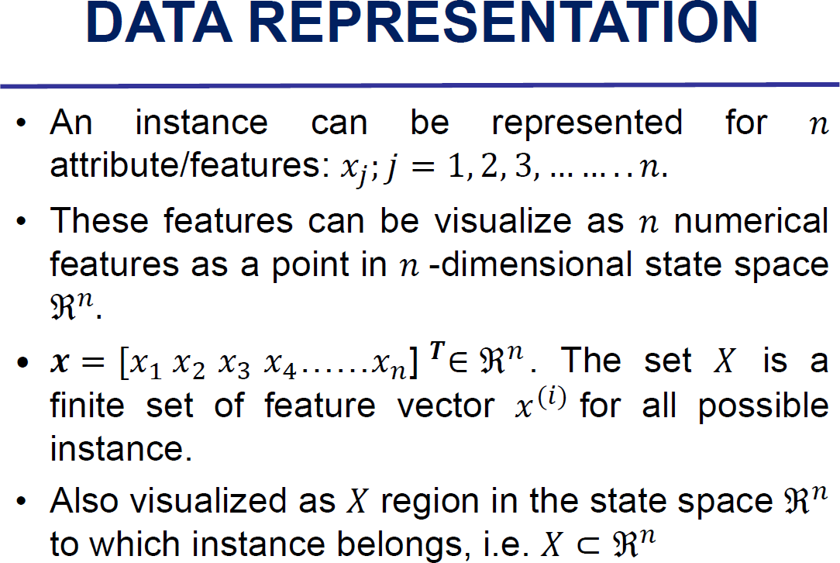
Lecture Presentation | Ruchika Pharswan @Delhi Technological University

Slide 45

Lecture Presentation | Ruchika Pharswan @Delhi Technological University

Slide 46
Data Diversity
Diversity of data -refers to the variety or heterogeneity of the data used to train and evaluate models.
Importance of Data Diversity
Improves Generalization:
A diverse dataset helps the model learn patterns that generalize well to new, unseen data. If the training data is diverse, the model is less likely to overfit to specific patterns that don't hold across all data points.
Avoids Bias:
Lack of diversity can lead to biased models.
For example, if a facial recognition system is trained only on images of people with a certain skin tone, it may perform poorly on images of people with different skin tones.
Captures Edge Cases:
Diverse data includes edge cases and rare situations, which are important for building robust models that
perform well across all possible inputs, not just the most common ones.
Reflects Real-World Complexity:
Real-world problems often involve complex and varied scenarios. Diverse data ensures that the model can handle this complexity and doesn't just perform well on a narrow subset of possible situations.
Lecture Presentation | Ruchika Pharswan @Delhi Technological University

Slide 47


Lecture Presentation | Ruchika Pharswan @Delhi Technological University

Slide 48




Guess the distribution ?
Lecture Presentation | Ruchika Pharswan @Delhi Technological University

Slide 49

Normal Distribution: More common in real-life data due to natural variations, the central limit theorem, and the
way multiple factors interact in complex systems.
A normal distribution, also known as a Gaussian distribution, is characterized by a symmetric, bell-shaped curve where most data points cluster around a central mean, with fewer points appearing as you move further from the mean.
Lecture Presentation | Ruchika Pharswan @Delhi Technological University

Slide 50



Feature Space
Lecture Presentation | Ruchika Pharswan @Delhi Technological University

Slide 51

Lecture Presentation | Ruchika Pharswan @Delhi Technological University

Slide 52


Lecture Presentation | Ruchika Pharswan @Delhi Technological University

Slide 53
Inductive Learning
Inductive learning is a key concept in machine learning where a model learns general rules from specific examples or data points. In this learning approach, the machine is provided with labeled training data, and from this, it attempts to infer a generalized function that can make predictions on unseen data
Key Idea of Inductive Learning
Specific to General: The model starts with specific instances (training data) and generalizes from these examples to learn a broader pattern or rule.
Learning from Observations: Inductive learning relies on learning patterns from observed data without assuming
the data fits into a pre-defined theory or structure.
How It Works
Training Data
Generalization 3.Prediction (tasks)
Lecture Presentation | Ruchika Pharswan @Delhi Technological University

Slide 54


Lecture Presentation | Ruchika Pharswan @Delhi Technological University

Slide 55


EXAMPLE : Lets take an example of loan approval system: learner uses examples from historical data to learn the function F(X), then applies it to new data for making predictions. (income, credit score, and employment history.)
Lecture Presentation | Ruchika Pharswan @Delhi Technological University

Slide 56


Hyper parameter vs Parameter / features
Lecture Presentation | Ruchika Pharswan @Delhi Technological University

Slide 57


Lecture Presentation | Ruchika Pharswan @Delhi Technological University

Slide 58



Types Of Classification

Slide 59


Which type of classification ?

Slide 60



Linear Regression

Slide 61


Slide 62



Linear
Weak Relationship
Strong Relationship

Slide 63





Slide 64



Slide 65




Slide 66









Slide 67






Slide 68


Slide 69



Another formula

Slide 70


Slide 71


Practice Question
X | Y
2 | 3
4 | 7
6 | 5
8 | 10

Slide 72






Decide –X and Y

Slide 73

Previous year question

Slide 74

Goodness of Fit
Goodness of Fit refers to how well a model fits the observed data. It measures the discrepancy between the observed data and the values predicted by the model. In simple terms, it helps us assess how well the chosen model explains the variability in the data.
Why is Goodness of Fit Important?
When building a model, especially in machine learning or statistical analysis, it's crucial to know whether the model you’ve created accurately represents the data or if it's underfitting or overfitting. A model with a good fit will make accurate predictions on both training data and unseen data (generalization).
SST: The total variability in the dependent variable.
SSR: The variability explained by the model.
SSE: The remaining variability not explained by the
model.
Together, these terms help evaluate the performance of a regression model and indicate how well it fits the data.
Lecture Presentation | Ruchika Pharswan @Delhi Technological University

Slide 75



Coefficient of Correlation
X | Y
1 | 1
2 | 1
3 | 2
4 | 2
5 | 4

Slide 76



Slide 77





Slide 78

ANOTHER FORMULA
Coefficient of Determination
Coefficient of Correlation

Slide 79






Slide 80





A correlation coefficient of 0.956 indicates a very strong
positive relationship between the two variables.
This means that 91.4% of the variability in the dependent variable 𝑌 can be explained by the independent variable 𝑋. The remaining 8.6% is due to factors not captured by the model.

Slide 81





Coefficient of Determination

Slide 82



Residual Analysis (also called errors)
A residual is the individual difference between the observed value and the predicted value for each data point in a regression model. Residuals show how much each data point deviates from the regression line.

Slide 83




Lecture Presentation | Ruchika Pharswan @Delhi Technological University

Slide 84



Slide 85



Slide 86



Slide 87





Standard Error of Estimate (SEE) (s) (σ ^2)
(s) Or

Slide 88



Slide 89


Practice Questions
The SEE of 0.60 means that, on average, the actual values of the dependent variable Y (observed values) differ
from the predicted values 𝑌^ by about 0.60 units.
In other words, the typical prediction error or residual is 0.60 units away from the actual data points.

Slide 90





Test of Slope Coefficient
Formula for the t-statistic:
estimated slope
2
standard error of the slope

Slide 91



Slide 92


You’re a marketing analyst for any Toys. You find β0 = –0.1, β1 = 0.7 and s = 0.6055 Is the relationship significant the .05 level of significance?
X | Y
1 | 2
2 | 3
3 | 5
4 | 4
5 | 6

Slide 93






Step 2: Calculate the Standard Error of the Slope
2
Given : s = 0.6055
t- calculated value

Slide 94




Another Formula
t- calculated value

Slide 95


At the 0.05 significance level (two-tailed test), we look up the critical t-value for 3 degrees of freedom. Using a t-distribution table, the critical value for 𝛼=0.05α=0.05 and 𝑑𝑓=3df=3 is approximately 3.182.

Slide 96


The calculated t-statistic is 3.654.
The critical t-value is 3.182.
Decision: we reject the null hypothesis.
Since ∣3.654∣>3.182

Slide 97


Slide 98




Linear regression with gradient Descent
This topic is part of optimization

Slide 99




Slide 100



Slide 101




Slide 102



Slide 103





Slide 104




Slide 105


EXPAND Function
Partial differentiation W.r.t “C”
Putting old value of “c” and “m ”
Gradient Value to determine first
iteration of “c” value i.e. new value

Slide 106


New “c” Value
Likewise :
Partial differentiation W.r.t “m”

Slide 107


Gradient Value to determine first iteration of “m” value i.e. new value
Putting old value of “c” and “m ”
New “m” Value

Slide 108


Slide 109
In Batch Gradient Descent we were considering all the examples for every step of Gradient Descent. But what if our dataset is very huge. Deep learning models crave for data. The more the data the more chances of a model to be good. Suppose our dataset has 5 million examples, then just to take one step the model will have to calculate the gradients of all the 5 million examples. This does not seem an efficient way.
It requires to calculate the gradients for the whole data set to perform just one update.
BGD can be very slow and is intractable for datasets that don't fit In memory ,it also doesn't allow us to update the model online i.e BGD isn’t performed on data set that update continuously.
To tackle this problem we have Stochastic Gradient Descent.

Slide 110


In Stochastic Gradient Descent (SGD), we consider just one example at a time to take a single step.
Stochastic gradient descent(SGD) performs a parameter update for each training example 𝑥(i) and label y(i).
Lecture Presentation | Ruchika Pharswan @ Delhi Technological University

Slide 111


While SGD’s fluctuation, on the one hand, enables it to jump to new and potentially better local minima On the other hand, this ultimately complicates convergence to the exact minimum, as SGD will keep overshooting

Slide 112


To tackle this problem we have Mini-Batch Gradient Descent.
Lecture Presentation | Ruchika Pharswan @ Delhi Technological University

Slide 113



Lecture Presentation | Ruchika Pharswan @Delhi Technological University

Slide 114


LECTURE PRESENTATION | RUCHIKA PHARSWAN @ DELHI TECHNOLOGICAL UNIVERSITY

Slide 115


What are Bias and Variance?
Bias
It can be defined as an inability of machine learning algorithms such as Linear Regression to capture the true relationship between the training data points
.
High bias, also known as underfitting, means the model did not learn enough from the dataset.
LECTURE PRESENTATION | RUCHIKA PHARSWAN @ DELHI TECHNOLOGICAL UNIVERSITY

Slide 116




What are Bias and Variance?
Variance
variance implies the error value that occurs when we try to make predictions by using data that is not previously seen by the model
High variance, also known as overfitting, means the model focuses too much on specific patterns in the training dataset and does not generalize well on unseen data.
LECTURE PRESENTATION | RUCHIKA PHARSWAN @ DELHI TECHNOLOGICAL UNIVERSITY

Slide 117

Performance Evaluation : Confusion matrix
The Confusion Matrix is a tool used to evaluate the performance of classification models in Machine Learning (ML). It is a square matrix that compares the predicted labels (output) with the actual labels (ground truth) of the data, giving a comprehensive view of how well the model is performing.
For a binary classification problem, the confusion matrix is a 2x2 matrix. It consists of four components:

Slide 118

True Positive
Interpretation: You predicted positive and it’s true (Actual -positive).
You predicted that a woman is pregnant and she actually is.
True Negative:
Interpretation: You predicted negative and it’s true ( Actual-nve). You predicted that a man is not pregnant and he actually is not.
False Positive: (Type 1 Error)
Interpretation: You predicted positive and it’s false (actual –nve)
False Negative: (Type 2 Error)
You predicted that a man is pregnant but he actually is not.
Interpretation: You predicted negative and it’s false (actual –positive).
You predicted that a woman is not pregnant but she actually is.

Slide 119



Several important metrics can be calculated using the values from the confusion matrix:
The above equation can be explained by saying, from all the classes we have predicted as positive, how many are actually positive.

Slide 120




Slide 121



Slide 122



The above equation can be explained by saying, from all the positive
classes, how many we predicted correctly.

Slide 123


Slide 124




Slide 125







Slide 126


Slide 127


Slide 128


Slide 129


Slide 130


Slide 131





Slide 132



Slide 133




Slide 134





Slide 135





Slide 136


Steps to calculate AUC

Slide 137





Slide 138



Slide 139



Slide 140





Slide 141




Another formula for AUC Calculation

Slide 142


Slide 143




Slide 144


Slide 145



Slide 146



Slide 147



Slide 148





Slide 149




Slide 150




Slide 151


Slide 152


Slide 153


Slide 154




Slide 155


Slide 156




Slide 157

All the Best, Prepare well
LECTURE PRESENTATION | RUCHIKA PHARSWAN @ DELHI TECHNOLOGICAL UNIVERSITY

